Slide 1
SAS MACRO TRAINING
With Phil Mason

Slide 2
Basics

Slide 3
What is a SAS Macro?
A macro is a way to automate processes in SAS
Macros can save time by giving you the opportunity to reuse the same code but with different variables
They can be used in and with any data step or proc step
You know it’s a macro when you see % or &
EG Example

Slide 4
Examples
Example – No Macro:
proc print data=sample.dib_prep_products_200607 ;
where dib_prod_code_10='CL00072';
run;
proc print data=sample.dib_prep_products_200607 ;
where dib_prod_code_10='CL00103';
run;
Example - With Macro:
%let prod_code=CL00072;
* %let prod_code=CL00103;
proc print data=sample.dib_prep_products_200607;
where dib_prod_code_10="&prod_code.";
run;
EG Example

Slide 5
Macro Variables – Basics
%let
Assign a macro variable
&
Reference a macro variable
The dot gets gobbled up
&var vs. &var.
Be careful of what quotes you use
“&var” vs. ‘&var’

Slide 6
Assigning Macro variables
The simplest way to assign a value to a macro variable is %LET
The syntax is as follows:
%let prod_code = CL00072;
You then use an ampersand when referencing the variable:

Slide 7
How %let works with &
If you create a macro variable called “cell”;
%let cell=7;
Anytime after this in your code, &cell. will be replaced by 7
Example
%let prod_code=CL00072;
proc print data=sample.dib_prep_products_200607;
where dib_prod_code_10="&prod_code.";
run;
proc print data=sample.dib_prep_products_200607;
where dib_prod_code_10=“CL00072”;
run;
EG Example
Notes:
Go to EG for demo

Slide 8
The %LET Statement – Rules
Occurs Outside of a DATA or PROC Step:
%let num_obs=100;
proc print data=sample.dib_prep_stores_200607
(keep=dib_store_code dib_store_name dib_store_region obs=&num_obs) noobs;
run;
EG Example
Notes:
Go to EG so easier to see

Slide 9
The %LET Statement – Rules
Numeric values stored as strings:
%let week_number=200818;
data work.baskets;
set sample.dib_prep_baskets
(keep=dib_basket_key dib_basket_quantity);
where dib_week_number_character="&week_number.";
run;
Quotes
OR
%let qty=10;
data work.baskets;
set sample.dib_prep_basks_200818
(keep=dib_basket_key dib_basket_quantity);
where dib_basket_quantity=&qty.;
run;
No Quotes
EG Example
Notes:
Go to EG for demo discussion

Slide 10
The %LET Statement – Rules
They are case-sensitive:
%let prod_code=CL00072; ≠ %let prod_code=cl00072;
Quotation Marks are included as part of the value:
%let prod_code=‘CL00072’; ≠ %let prod_code=CL00072;
NEVER: Put quotation marks in a macro variable
Mathematical expressions are not evaluated:
%let total=3+4; means &total.=3+4 not &total.=7
The value of a macro variable doesn’t change until it’s overwritten
Blanks around the value are automatically removed:
%let prod_code= CL00072 ; = %let prod_code=CL00072;
The maximum length of a macro variable is 65,534 characters
Notes:
Now let’s look at the rules of % let in action

Slide 11
Macro programs
%let can be used to assign a value to macro variable in open (normal) code. However, a much more powerful use of macros is the macro program.
The macro is called printing
The macro has one parameter: prod_code
Tells SAS you are defining a macro
%macro printing(prod_code);
proc print data=sample.dib_prep_products_200607;
where dib_prod_code_10="&prod_code.";
run;
%mend printing;
%printing(CL00072)
%printing(CL00103)
Add the code the macro runs
Close off the macro definition with a %mend
Invoke the macro %printing multiple times
telling it what the value of prod_code is
EG Example
Notes:
Add name of macro to %mend. Not required but makes it SO MUCH easier to read and debug your code.
Go to EG for demo
What happens when you leave off %MEND?
WARNING: The quoted string currently being processed has become more than 262 characters long. You may have unbalanced quotation
marks.
Semi colon is not required and can actually cause errors when macros are nested together.

Slide 12
Macro programs
It is possible to add as many parameters to a macro program as necessary.
In this macro, we already had prod_code which allowed us to specify the product code. This is a positional parameter which must be entered when calling the macro.
We’ve now also added week
As this is followed by an = sign, this is a keyword parameter and is optional
You can specify a default value so that it does not always need to be entered
%macro printing(prod_code,week=201106);
proc print data=sample.dib_prep_products_&week.;
where dib_prod_code_10="&prod_code.";
run;
%mend printing;
%printing(CL00072)
%printing(CL00103,week=201106)
EG Example
Notes:
Add name of macro to %mend. Not required but makes it SO MUCH easier to read and debug your code.
Go to EG for demo
What happens when you leave off %MEND?
WARNING: The quoted string currently being processed has become more than 262 characters long. You may have unbalanced quotation
marks.
Semi colon is not required and can actually cause errors when macros are nested together.

Slide 13
Creating positional and keyword parameters when defining a macro
Mandatory
Optional
A keyword parameter, defined with a default value of 10
%macro show_results(dataset, numobs=10);
<code>
%mend;
Positional parameters must appear before keyword parameters in the macro definition.
Calling the macro:
%show_results(results_data, numobs=20)
or
%show_results(results_data)
Mandatory
Optional
Mandatory
EG Example
Notes:
Assigning defaults to keywords
Go to EG for more in depth demo on positional and keyword parameters

Slide 14
Macros Aren’t Always Efficient
Macros allow you to automate the repetition of the same piece of code with different inputs each time
Macros can actually make a system slower by making it easier to:
run slow/inefficient code against multiple variables
run the same code multiple times
read the same data multiple times
Apply methods from the SAS Efficiencies course in order to write optimized code
Remember to use macros only after you have optimized your code

Slide 15
Evaluating numeric expressions in macro language
%let total=%eval(1+1) ;
%let circumference=%sysevalf(2*3.14159*&r) ;
Eval only works on integers
%eval(1.1+0.2) will fail

Slide 16
Arithmetic calculations in macros
%EVAL is a bit stupid
Numbers with dots are characters
Treats all numbers as integers
%SYSEVALF is clever
Knows what a number is
Does it in Floating Point

Slide 17
Trimming leading and trailing blanks
&name has a value of “ Phil Mason “
%left(&name) … “Phil Mason “
%trim(&name) … “ Phil Mason“
%left(%trim(&name)) … “Phil Mason“

Slide 18
Searching & extracting text from macro variables
Find starting position of some text in a macro variable
%let position=%index(&address,road) ;
Extract some text from some text
%let text=%substr(&address,12,3) ;
Get the nth word from a some text
%let street=%scan(&address,2) ;

Slide 19
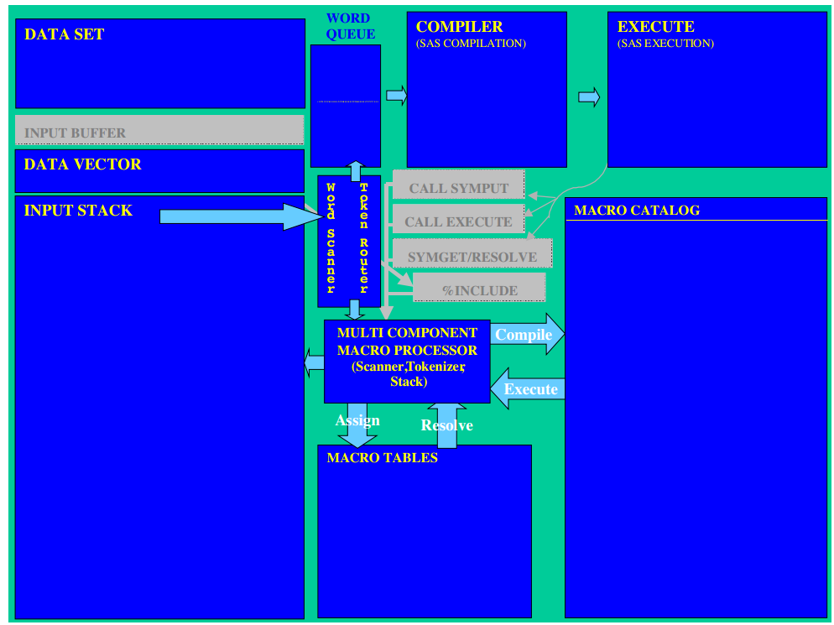
Macro Processing – behind the scenes

Slide 20
Commenting macros
Several kinds of SAS comments
Type 1
Can go anywhere in SAS code
Not tokenized, not stored in macro, can contain semi-colons, single quotes and so on
Best to use sparingly since they are great for commenting out code
Type 2
Is tokenized and stored in compiled macro
Best for Base SAS code, as part of data steps, Procs, etc.
/* this is a comment */
* this is a comment ;

Slide 21
Commenting macros
Several kinds of SAS comments
Type 3
Quotes must match, can’t contain semi-colons
Displayed even if nomprint option is used
Best for use in macro code
Type 4
Is tokenized and stored in compiled macro
Old style comment kept for compatibility with older releases – avoid
Also …
Can comment any SAS code out by turning it into a macro definition
%* this is a comment ;
Comment this is a comment ;
%macro dummy ;
Various SAS code
%mend dummy ;

Slide 22
Clever Commenting
Can define macro variables which contain comment symbols
Enables comments in several places to be enabled or disabled from one place
Useful for debugging since debugging code can be enabled or commented out easily
%let a=/;%let b=*;
&a&b
proc print data=x ;
run ;
*/;
data _null_ ;
run ;

Slide 23
Write to the log in colour
Use ERROR, WARNING or NOTE to generate output in various colours
The keywords must be in uppercase, or it wont work
Default colours produced, though these can be redefined
ERROR: produces red output
WARNING: produces green output
NOTE: produces blue output
Specifying a dash in place of the colon causes the ERROR, WARNING or NOTE text to be blanked out
%put ERROR: This is an error ;
%put WARNING: This is a warning ;
%put NOTE: Take note ;
%put ERROR- This is an error ;
%put WARNING- This is a warning ;
%put NOTE- Take note ;

Slide 24
Conditional logic - %if %then %do
%if allows you to check if a certain condition is true and if it is, pass the code to be run. %else allows you to check for multiple conditions.
%if must be used inside a macro
%let proj_type=Store_Level ;
%macro project_title;
%if &proj_type=Store_Level %then %do;
title “Analysing Store Campaign” ;
%end;
%else %do;
title “Analysing National Campaign” ;
%end;
%mend project_title;
%project_title
Indent your code to make it easy to see where one %do ends
%else is optional; if the %if condition is false SAS will just move onto the next piece of code
EG Example
Notes:
These must be placed inside a macro as per the slide on macro programs – hence why using a macro program is so much more powerful.
Talk about using comments to match %if with %end

Slide 25
Conditional logic doesn’t interact with a datastep
The two sets of code look very similar but are actually quite different
data new_data; set sales_data; %if month ="DEC" %then %do; end_of_year="Y"; %end; %else %do; end_of_year="N"; %end; run; | data new_data; set sales_data; if month="DEC" then do; end_of_year="Y"; end; else do; end_of_year="N"; end; run;
INCORRECT
Month is a dataset variable (not the macro variable &month.)
The value will change within the dataset. As the macro is compiled before any data is read in, this cannot work
CORRECT
If the dataset variable month has the value ‘DEC’ then make the variable end_of_year=‘Y’ for the observation
Notes:
Ask class what they think will happen
Add dataset to flipchart in advance

Slide 26
Iterative %do; %end; loops
Another way %do is used is to generate the same piece of code multiple times
%macro pull_data(outdata, indata, start, end);
data &outdata.;
set
%do i = &start. %to &end.;
&indata._&i
%end;
;
run;
%mend;
%pull_data(dib_prep_basks, sample.dib_prep_basks, 200817, 200819);
Note the lack of a semi colon at the end of the line
Set multiple datasets together without having to specify each one individually
data dib_prep_basks;
set sample.dib_prep_basks_200817
sample.dib_prep_basks_200818
sample.dib_prep_basks_200819
;
run;
EG Example
Notes:
N.B. haven’t covered off the dot yet – will explain later.

Slide 27
%do; %end; is not the same as a do; end; loop
Macros are used to write code
a %do; %end; loop will allow you to generate multiple lines of code.
do; end; performs an operation multiple times, but it does not generate multiple lines of code in the way the %do; %end; does.
Again %do; %end; must be placed inside a macro.
Notes:
%do % end is based on the code you are generating – before the data arrives. Macros aren’t data dependent.
Do end is actually working within the data – so the data has to have arrived.

Slide 28
Carry out a loop while a condition is met
Will not process loop at all if condition is not met
Condition is evaluated at start of loop
%do %while(&a<&b);
%do %while(%length(&name)>20);

Slide 29
Carry out a loop until a condition is met
Will do loop at least once
Evaluates condition at the end of loop
%do %until(&hold=no);
%do %until(%index(&source,&excerpt)=0);

Slide 30
& versus && versus &&&
In Base SAS
&name refers to a macro variable called name
&&name is scanned twice by macro processor
&&&name is treated as &(&name)
If used in SCL – SAS/AF
&name tries to substitute SCL variable name, if it exists
If it does not exist, then it looks for a macro variable called name
&&name is useful since it doesn’t try to substitute an SCL variable even if one exists of that name, but uses the macro variable
&&&name works as in Base SAS

Slide 31
Complex Resolving – Multiple Ampersands
Sometimes you’ll want to use the value from one macro variable in order to use another macro variable to produce a result
Example :
Produce a line in the log for each macro variable using the cell number to return its value so the log reads:
cell number 1 is called : HH
cell number 2 is called : HM
cell number 3 is called : NN
%let cell1 = HH;
%let cell2 = HM;
%let cell3 = NN;

Slide 32
Complex Resolving - Multiple Ampersands
There are 3 rules:
Rule number 1: Two ampersands (&&) are replaced by one ampersand (&)
Rule number 2: A single ampersand (&) will be paired with the subsequent fullstop (.) and the contents of this string will be resolved as a macro variable
Eg: Where the code sees &cell. it will replace it with the value of the macro variable called cell.
Rule number 3: SAS will go through the whole piece of code from start to finish applying these rules once in each instance. It will then repeat this process until all ampersands have been resolved.
Notes:
Treat as reference – don’t spend ages explaining it. There’s an example coming.

Slide 33
Complex Resolving - Multiple Ampersands
Sometimes you’ll want to use the value from one macro variable in order use another macro variable to produce a result
Example
%let cell1 = HH;
%let cell2 = HM;
%let cell3 = NN;
%macro print_cell_names;
%do index = 1 %to 3;
%put cell number &index. is called &&cell&index..;
%end;
%mend;
%print_cell_names
&& resolves to &
& cell 3;
&index. resolves to 3
NN
&cell3. resolves to NN
EG Example
Notes:
Go to EG and demo

Slide 34
Deriving macro variables from data
Using data steps
Call symput vs symputx
symget
Using Proc SQL
Select into :var
Separated by

Slide 35
Writing to macro variables from data steps
1 data _null_ ;
2 date=date() ;
3 call symput('title',put(date,worddate.)) ;
4 run ;
NOTE: DATA statement used (Total process time):
real time 0.00 seconds
cpu time 0.00 seconds
5 %put title=&title ;
title= December 17, 2014
6 title "&title" ;
7 proc print data=sashelp.class ;
8 run ;
Call Symputx() trims the leading and trailing blanks before writing to macro variable.

Slide 36
Getting macro variables into data steps
1 data _null_ ;
2 user=symget('_metauser') ;
3 info=resolve('We are running on &_SASHOSTNAME') ;
4 put user= / info= ;
5 run ;
user=pmason@CFSI
info=We are running on 'KH-PROD-GMAN.cfsi.local'

Slide 37
Derive Macro Variables From Data
Although %LET is extremely simple to use, it’s not usually the most efficient way to work because it requires you to hard code the values into SAS
A much more efficient approach is let the macro variables be data driven
SAS offers two ways to generate data driven macro variables:
CALL SYMPUTX which creates a macro variable (call symput in CV)
SYMGET which retrieves a macro variables value
Both commands are populated at execution time
Notes:
%let is great for when you have one piece of code that you want to you many time at different times.
e.g. a report you run once a month. Each month you open the code, change the weekno in the %let and run it. Not so good if you want to do something multiple times within the same code as you keep having to change the %let – not really in the sprit of macros as it’s manual intervention.

Slide 38
CALL SYMPUTX
Most common way that data driven macro variables are created
CALL SYMPUTX is new to SAS Version 9. In previous versions of SAS, only CALL SYMPUT is available.
SYMPUTX is more useful because it:
automatically trims leading and trailing spaces
automatically converts numeric variables to character using the BEST12. format
SYMPUTX is not backwards compatible
A maximum of 32,767 characters can be assigned to the receiving macro variable
Called from within a DATA STEP
Resulting macro variable can contain one and only one value at a time

Slide 39
CALL SYMPUTX
The syntax is as follows:
call symputx(<macro_variable_name>,<dataset field>)
Example - Incorrect
data _null_;
set sample.dib_prep_stores_200607;
call symputx('store',dib_store_code);
run;
The store macro variable can contain only one value so SAS populates it with the last value in the dataset
Example - Correct
data _null_;
set sample.dib_prep_stores_200607;
call symputx('store',dib_store_code);
where dib_store_name='STORE_E02_00001';
run;
Control the value stored within the macro variable by using either a WHERE clause or a SUBSETTING IF
EG Example
Notes:
Also refer to eof example – the one I use most often.
Or use obs=1 if you want info that can be found in all (including the first) lines

Slide 40
Generating Multiple Data Derived Macro Variables Simultaneously
You can use the SAS Global Symbol table to store values so that you can use it as a type of look-up table
CALL SYMPUTX can be used in conjunction with concatenation to store multiple distinct values
This eliminates needs for joins and sorts
Uses RAM instead of I/O
Increases flexibility because macro variables can be used in a number of ways
Not always appropriate – use common sense
If you need to look up hundreds of thousands of values, then a Hash Object would be better
Notes:
Global symbol table covered in advanced course

Slide 41
Generating Multiple Data Derived Macro Variables Simultaneously
The syntax for generating multiple macro variables is as follows:
symputx(cats(‘<name_for_macro_variable>’,<field_name_from_table_to_attach_to_macro_var>’),<value_to_assign_to_macro_var>)
Example
data _null_;
set sample.dib_prep_stores_200607(obs=10);
call symputx(cats('store_name',dib_store_code),dib_store_name);
run;
Macro var name
Value assigned to macro var
Attach value to macro var name so that macro variable will be unique

Slide 42
Generating Multiple Data Derived Macro Variables Simultaneously
Results
Now you can obtain the store name for any table that contains store id without having to open or join to the store table again
Macro var name
GLOBAL STORE_NAMESTORE00001 STORE_E02_00001
GLOBAL STORE_NAMESTORE00002 STORE_W01_00002
GLOBAL STORE_NAMESTORE00003 STORE_E01_00003
GLOBAL STORE_NAMESTORE00004 STORE_E03_00004
GLOBAL STORE_NAMESTORE00006 STORE_S01_00006
GLOBAL STORE_NAMESTORE00007 STORE_W02_00007
GLOBAL STORE_NAMESTORE00008 STORE_N01_00008
GLOBAL STORE_NAMESTORE00011 STORE_W03_00011
GLOBAL STORE_NAMESTORE00013 STORE_N02_00013
GLOBAL STORE_NAMESTORE00015 STORE_E02_00015
Values assigned to macro var

Slide 43
Retrieving Multiple Data Derived Macro Variables Simultaneously
Example
Result
%let store_id=STORE00013;
proc print data=sample.dib_prep_basks_200819;
where dib_store_code="&store_id.";
var dib_basket_key dib_basket_spend dib_basket_quantity;
title1 "Store ID: &store_id.";
title2 "Store Name: &&store_name&store_id..";
run;
Look for “store_name” macro var and resolve using store_id
GLOBAL STORE_NAMESTORE00013 STORE_N02_00013
Store Name is returned without having to join to store table
Store ID: STORE00013
Store Name: STORE_N02_00013
EG Example

Slide 44
SYMGET
Is another way to retrieve values for macro variables from the Global Symbol table
Can be specified as either a character literal or a DATA STEP character expression
A DATA STEP variable created by SYMGET will automatically be 200 bytes long.
So make sure that you define the variable and its length in order to maximize efficiency
Notes:
Could think of it as the opposite of a call symput

Slide 45
SYMGET
The syntax is as follows:
<Variable>=symget(<macro_variable_name>);
Example
Put store and store code fields first so easier to QA
data work.stores;
retain store dib_store_code;
set sample.dib_prep_basks_200819;
attrib store length=$35.;
where dib_store_code in ('STORE00013','STORE00001');
store=symget('store_name'||left(dib_store_code));
run;
Assign length to store field
Populate the store field with the store name using the Global Symbol Table
GLOBAL STORE_NAMESTORE00013 STORE_N02_00013
Now every dib_store_code in the baskets table will have the store name associated with it without having to join to the store table
STORE DIB_STORE_CODE
STORE_N02_00013 STORE00013
STORE_E02_00001 STORE00001
Notes:
For each line of data you have a different value for dib_store_code. So you can’t hardcode the store code that you want – you use the data to drive it. (Can’t use “&”)
&store_name.dib_store_code: SAS would attempt to resolve in the macro processor when “dib_store_code” doesn’t yet exist – we haven’t read the data in yet!
Symput with a symget – use to get round the fact that & means SAS resolves the macro variable too early.
Mention that symget is also useful if you want to use a macro var in the same datastep you created it in.

Slide 46
Deriving macro variables from data using proc sql
PROC SQL can be used to create Macro variables from datasets
proc sql noprint ;
select count(*), sum(sales)
into :numobs, :tot_sales
from table1;
quit;
However, there are more efficient ways to do the above using a datastep; a more useful application is to use it to read in the contents of an entire column of data.
If weekno were a character variable then you would write
“select quote(weekno)”
proc sql noprint ;
select weekno into :weeklist separated by ","
from table1;
quit;
Then you can just refer to the macro variable &weeklist. instead of having to type 200901, 200902,…
Notes:
Useful for tpns, store numbers etc

Slide 47
Debugging
Two techniques
See all variables in the Symbol Table
See how variables are resolved when a macro program executes
Results are printed to the SAS Log
Notes:
We got to here in 1st session with Carl & Stewart.

Slide 48
Debugging – View Macro Variables in Symbol Table
First Technique Review - %put <some text> <macro_variable>;
Resolved after execution
Shows value for a specific macro variable
Example
%let store=STORE00013;
%put store is &store;
SAS LOG
store is STORE00013

Slide 49
Debugging – View Macro Variables in Symbol Table
%put _user_;
Resolved after execution
Shows value of user-defined global macro variables in your session
Example
data _null_;
set sample.dib_prep_stores_200607(obs=5);
call symputx(cats('store_name',dib_store_code),dib_store_name);
run;
%put _user_;
SAS LOG
GLOBAL STORE_NAMESTORE00001 STORE_E02_00001
GLOBAL STORE_NAMESTORE00002 STORE_W01_00002
GLOBAL STORE_NAMESTORE00003 STORE_E01_00003
GLOBAL STORE_NAMESTORE00004 STORE_E03_00004
GLOBAL STORE_NAMESTORE00006 STORE_S01_00006
GLOBAL STORE STORE00013
Even previously defined macro vars are displayed with the %put _user_ command

Slide 50
Debugging – View Macro Variable Resolution Within A Macro Program
Macro programs offer 3 debugging techniques
SYMBOLGEN
Shows value of macro variables for program and for a specific loop
MPRINT
Shows all code and fully resolved statements and values
MLOGIC
Shows logic within code and how macro variables were used within conditional statements
These are session options
Turn on: options symbolgen mprint mlogic;
Turn off: options nosymbolgen nomprint nomlogic;
Results can be verbose
Results are printed for every macro variable used for that macro program
Notes:
Options symbolgen mprint mlogic;
%clevermacro(firstrun)
options nosymbolgen nomprint nomlogic;
%clevermacro(secondrun)
%clevermacro(thirdrun)
For QA purposes…

Slide 51
Debugging – View Macro Variable Resolution Within A Macro Program
Example
options symbolgen mprint mlogic;
%macro stats_while(datasets);
%let i=1;
%let dsn=%scan(&datasets,1);
%do %while (&dsn ne );
title "SAMPLE.%upcase(&dsn)";
proc means data=sample.&dsn n;
run;
%let i=%eval(&i+1);
%let dsn=%scan(&datasets,&i);
%end;
%mend stats_while;
%stats_while(dib_prep_stores_200607 dib_prep_products_200607)
Debugging options turned on
EG Example

Slide 52
Debugging – View Macro Variable Resolution Within A Macro Program
Indicates start of macro program
Results – 1st loop
MLOGIC(STATS_WHILE): Beginning execution.
MLOGIC(STATS_WHILE): Parameter DATASETS has value dib_prep_stores_200607 dib_prep_products_200607
MLOGIC(STATS_WHILE): %LET (variable name is I)
MLOGIC(STATS_WHILE): %LET (variable name is DSN)
SYMBOLGEN: Macro variable DATASETS resolves to dib_prep_stores_200607 dib_prep_products_200607
SYMBOLGEN: Macro variable DSN resolves to dib_prep_stores_200607
MLOGIC(STATS_WHILE): %DO %WHILE(&dsn ne) loop beginning; condition is TRUE.
SYMBOLGEN: Macro variable DSN resolves to dib_prep_stores_200607
MPRINT(STATS_WHILE): title "SAMPLE.DIB_PREP_STORES_200607";
SYMBOLGEN: Macro variable DSN resolves to dib_prep_stores_200607
MPRINT(STATS_WHILE): proc means data=sample.dib_prep_stores_200607 n;
MPRINT(STATS_WHILE): run;
NOTE: There were 761 observations read from the data set SAMPLE.DIB_PREP_STORES_200607.
NOTE: The PROCEDURE MEANS printed page 1.
NOTE: PROCEDURE MEANS used (Total process time):
real time 0.01 seconds
cpu time 0.01 seconds
Value of dsn macro var for this loop
Fully resolved value for statement
Run time results for this loop
Notes:
Emphasise difference between mprint and m logic – latter tells you why do loop will execute again for example. Not what you would see in open code.

Slide 53
Debugging – View Macro Variable Resolution Within A Macro Program
Results – 2nd loop
MLOGIC(STATS_WHILE): %LET (variable name is I)
SYMBOLGEN: Macro variable I resolves to 1
MLOGIC(STATS_WHILE): %LET (variable name is DSN)
SYMBOLGEN: Macro variable DATASETS resolves to dib_prep_stores_200607 dib_prep_products_200607
SYMBOLGEN: Macro variable I resolves to 2
SYMBOLGEN: Macro variable DSN resolves to dib_prep_products_200607
MLOGIC(STATS_WHILE): %DO %WHILE(&dsn ne) condition is TRUE; loop will iterate again.
SYMBOLGEN: Macro variable DSN resolves to dib_prep_products_200607
MPRINT(STATS_WHILE): title "SAMPLE.DIB_PREP_PRODUCTS_200607";
SYMBOLGEN: Macro variable DSN resolves to dib_prep_products_200607
MPRINT(STATS_WHILE): proc means data=sample.dib_prep_products_200607 n;
MPRINT(STATS_WHILE): run;
NOTE: PROCEDURE MEANS used (Total process time):
real time 0.01 seconds
cpu time 0.02 seconds
NOTE: There were 4997 observations read from the data set SAMPLE.DIB_PREP_PRODUCTS_200607.
NOTE: The PROCEDURE MEANS printed page 2.
Notes:
Do while still true so we go again

Slide 54
Debugging – View Macro Variable Resolution Within A Macro Program
Results – End
MLOGIC(STATS_WHILE): %LET (variable name is I)
SYMBOLGEN: Macro variable I resolves to 2
MLOGIC(STATS_WHILE): %LET (variable name is DSN)
SYMBOLGEN: Macro variable DATASETS resolves to dib_prep_stores_200607 dib_prep_products_200607
SYMBOLGEN: Macro variable I resolves to 3
SYMBOLGEN: Macro variable DSN resolves to
MLOGIC(STATS_WHILE): %DO %WHILE() condition is FALSE; loop will not iterate again.
MLOGIC(STATS_WHILE): Ending execution.
Indicates end of macro program
Notes:
Now we’ve reached the end. “loop will not iterate again”

Slide 55
Things to be aware of
Some macro statements can be used in open code and some cant
%let is OK, %if is not OK

Slide 56
Advanced

Slide 57
Some different ways to use Call Execute
Builds SAS code which is run after the current data step completes
useful for:
building macro definitions
Building macro invocations
Building data step code
Passing data step values to macros as parameters
Call execute('%macro runit;%let this=that;%mend runit’);
Call execute(‘%runit’) ;
Call execute(‘data _null_;x=1;run;’) ;
Data _null_ ;
set info ;
call execute(‘%invoice(‘!!customer!!’);’) ;

Slide 58
Syntax of RESOLVE() function
RESOLVE(argument)
Resolves the value of a text expression during DATA step execution
Resolve() works with a macro variable or macro invocation at data step execution time
Argument must be in single quotes, otherwise it will be resolved before the data step is run

Slide 59
Resolving macro expressions at data step execution time
Why use resolve()?
useful for passing macro values in to data step at data step execution time
Accepts a wider range of arguments than symget
Can resolve macro variables or macro programs
Can resolve more than one macro variable at once
Can return different values at each iteration of the data step
X=resolve(‘&name’) ;
Y=resolve(‘%get_name’) ;
Z=resolve(‘&first &last’) ;

Slide 60
Macro variable scope
Global Symbol table
Holds macro variables available throughout all of SAS session.
Local Symbol table
Holds macro variables only available within the currently executing macro program.
Automatic Macro Variables
Created and populated by SAS

Slide 61
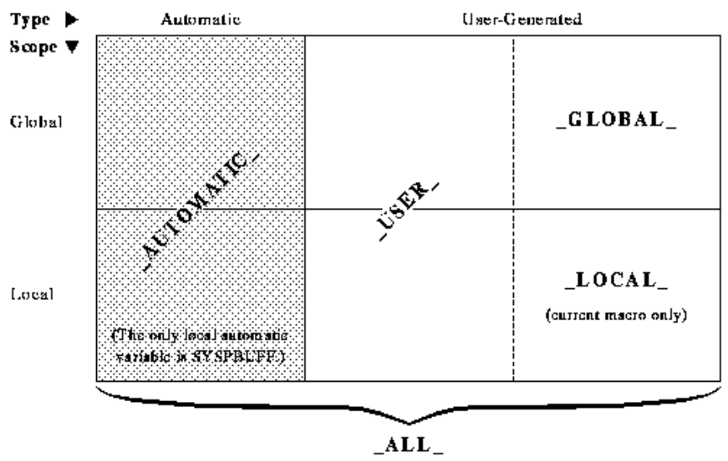
Macro variables
Use %put to show macro variables
_all_ = all macro variables
_automatic_ = automatically created by SAS
_global_ = all global macro variables
_local_ = all local macro variables in context
_user_ = all local & global macro variables created by the user.

Slide 62
Some useful return codes
&syserr … Procs, Data steps
Re-assign before use in SYMGET()
&sysfilrc … Filename statements
&syslibrc … Libname statements
&sysrc … System commands
Need XSYNC option set
Return code from Libname(), Filename(), System()

Slide 63
Syntax for %SYSFUNC
Execute SAS functions or user-written functions
function is the name of the function
format is a SAS format to apply to the results.
Qsysfunc is the same as Sysfunc except it masks the same characters as the %NRBQUOTE function, i.e.
& % ' " ( ) + - * / < > = ¬ ^ ~ ; , blank AND OR NOT EQ NE LE LT GE GT
%SYSFUNC (function(argument(s))<,format>)
%QSYSFUNC (function(argument(s))<,format>)

Slide 64
Putting dates into Titles and Footnotes
Putting a date into a title
To make more sense of it we can use the format parameter
Title "Today is %sysfunc(date())" ;
Footnote "Today is %sysfunc(date(),worddate.)" ;
REVISION

Slide 65
Functions that can be used with %sysfunc
Some functions that are available
Time, Date & datetime
Date & time values
Putn, putc, inputn, inputc
Combination of values with formats
Exist, fexist
Existence of files/datasets
Open, close, attrn, attrc
Sas dataset I/O
Intck, intnx
Increments & counts datetime intervals
Pathname
Gets physical file assignments
Log, min, max, sum
Mathematical functions
Some functions
which are not available
DIF
DIM
HBOUND
IORCMSG
INPUT
LAG
LBOUND
MISSING
PUT
RESOLVE
SYMGET
All Variable Information Functions

Slide 66
Multiple functions in one statement
Multiple functions can be done in one statement
You might try this…
%let name=%sysfunc(hour(timepart(datetime())) ;
But you need a %sysfunc for each function used, so it should be
%let name=%sysfunc(hour(%sysfunc(timepart(%sysfunc(datetime()))))) ;

Slide 67
Creating macro variable from Data Set variables
Using %sysfunc you can do dataset I/O in the macro environment.
When getting a variable value from dataset it is assigned a macro variable
The Set() function therefore assigns all variables to macro variables
%let dsid=%sysfunc(open(sasuser.houses,i)) ;
%syscall set(dsid) ;
%let rc=%sysfunc(fetch(&dsid)) ;
%let rc=%sysfunc(close(&dsid)) ;
%put _all_ ;

Slide 68
Counting words in an expression
Here is one of the best ways to count words in an expression
Uses compbl to compress blanks so there is one between each word
Uses compress to eliminate all other letters.
%let longword=this is a very very long word;
%let numword=%eval(%length(
%sysfunc(compbl(&longword)))-
%length(%sysfunc(compress(&longword)))+1);
%put >&numword<;

Slide 69
Determine if a dataset exists
We can detect if a dataset exists and do something if it does, and something else if it doesn’t.
%macro test ;
%if %sysfunc(exist(sashelp.class)) %then %do ;
proc print data=sashelp.class ;
run ;
%end ;
%else
%put sashelp.class does not exist. ;
%mend test ;
%test ;

Slide 70
Get values from a table
Open a dataset with a where clause applied
Fetch a row
If found then return the value, otherwise return “unknown”
Close the dataset
%macro how_old(name) ;
%let dsid=%sysfunc(open(sashelp.class(where=(name="&name")))) ;
%let rc=%sysfunc(fetch(&dsid)) ;
%if &rc=0 %then %sysfunc(getvarn(&dsid,%sysfunc(varnum(&dsid,age)))) ;
%else unknown ;
%let dsid=%sysfunc(close(&dsid)) ;
%mend how_old ;
%put Alfred is %how_old(Alfred) ;
Alfred is 14

Slide 71
Get attributes from a table
Open dataset
Use the attrn function to return the number of observations
Close dataset
%macro number_of_rows(dataset) ;
%let dsid=%sysfunc(open(&dataset)) ;
%sysfunc(attrn(&dsid,nobs))
%let dsid=%sysfunc(close(&dsid)) ;
%mend number_of_rows ;
%put sashelp.prdsale has %number_of_rows(sashelp.prdsale) rows. ;
sashelp.prdsale has 1440 rows.

Slide 72
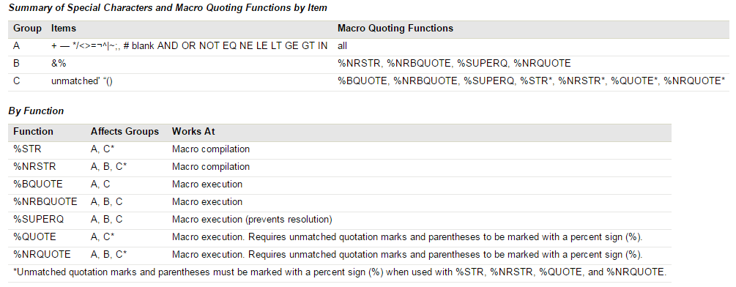
Character quoting/masking

Slide 73
Using %SUPERQ when you want to ignore macro functionality
%SUPERQ is the only macro function which prevents resolution of all macro variables
Only accepts the name of a macro variable, without ampersand
Takes a “picture” of the macro variable contents
Does not do any resolution

Slide 74
Example of masking all macro resolution using %SUPERQ
data _null_;
call symput('mv1','Smith&Jones');
call symput('mv2','%macro abc;');
run;
%put Macro variable TESTMV1 is &mv1;
%put Macro variable TESTMV2 is &mv2;
WARNING: Apparent symbolic reference JONES not resolved.
ERROR: Open code statement recursion detected.
%put Macro variable TESTMV1 is %superq(mv1);
%put Macro variable TESTMV2 is %superq(mv2);
Macro variable TESTMV1 is Smith&Jones
Macro variable TESTMV2 is %macro abc;

Slide 75
%unquote
Quoting removes the meaning of special characters
Unquoting restores the meaning of special characters
%let val = aaa ;
%let testval = %str(%'&val%') ;
data _null_ ;
val = &testval ;
put 'VAL =' val ;
run;
%let val = aaa ;
%let testval = %str(%'&val%') ;
data _null_ ;
val = %unquote(&testval) ;
put 'VAL =' val ;
run;

Slide 76
File functions in macros
Fileexist
Fopen, fclose
Fread

Slide 77
Directory functions in macros
Filename function allocates a fileref pointing to a directory
Dopen open the directory
Dnum tells you how many items are in it
Dclose closes the directory
%let path=c:\;
%let dir=my_dir ;
%let rc=%sysfunc(filename(dir,&path)) ;
%let did=%sysfunc(dopen(&dir)) ;
%let memcount=%sysfunc(dnum(&did)) ;
%put There are &memcount items in &path ;
%let did=%sysfunc(dclose(&did)) ;

Slide 78
Advanced topics
Parmbuff
%goto and %label:
%sysget
%sysexec

Slide 79
Unspecified macro parameters
Example
Produces the following output
%macro sales(a,type=) / parmbuff ;
%put a=&a type=&type syspbuff=&syspbuff;
%mend sales ;
%sales(car,red green blue,type=10) ;
a=car type=10 syspbuff=(car,red green blue,type=10)

Slide 80
Syntax of %GOTO and %label:
%GOTO label;
Branches macro processing to the specified label
Can be a shortcut method of coding, but generally not good practice to use
Can produce spaghetti code
Label can be either an actual label or a macro variable or invocation which resolves to a macro label
Defines a label which can be used in a %GOTO statement
Labels are defined using “%name:” followed by a macro statement, text expression or constant text
%label: macro-text

Slide 81
Ways to use %GOTO
If we have the following label definitions…
Then we can go to it like this …
Or this …
Or this …
%lab1: %let this=that ;
%lab2: %mend ;
%lab3: x=x+2 ;
%goto lab1 ;
%let lab=lab2;
%goto &lab;
%macro lab ;
lab2
%mend lab ;
%goto %lab ;

Slide 82
Get environment variables
Open a command windows and enter set
This shows all the currently defined environment variables
1 %put We have %sysget(number_of_processors) processors on this %sysget(computername)
1 ! ;
We have 16 processors on this KH-PROD-GNODE3

Slide 83
%sysexec
Run operating system commands from macro environment
Same as the X command, but commands shouldn’t be in quotes
%sysexec del myfile.txt ;

Slide 84
Macro Search Path
When a macro is invoked (e.g. %myreport) SAS searches for it in these places in this sequence:
Work.Sasmacr
Standard macros compiled in the current SAS session are stored here
Compiled Stored Macros
This is searched if options are set appropriately
Autocall Macros
This is defined in SAS config file and can be modified using options

Slide 85
Stored Compiled macros
How to create a stored compiled macro
Advantages
Saves compile time when macro is used
More secure since source code is not kept with executable
options mstored sasmstore=sasuser ;
%macro test / store ;
%put This was stored away ;
%mend test ;
REVISION

Slide 86
Writing generated macro code for analysis
Causes code generated by macros to be written to an external file.
File can’t be accessed until the SAS session has ended
Write code generated by macros to an external file
OPTIONS MFILE MPRINT ; FILENAME MPRINT 'c:\macro.sas' ;
Very useful for complex macros with many loops and multi-ampersands
You can then run the code generated through data step debugger

Slide 87
Good Coding Practice Rules
Always use a header that includes the title of your code, service line, date, and who wrote the code
Define system options at the TOP of the code
Define all simple macro variables (e.g., %let) at the TOP of the code
When you want to reset values for macro variables it’s easier to do if you don’t have to hunt through the code for them
Define all libnames and directories at the TOP of the code
Use indentation especially when using conditional logic
Use comments and make them relevant throughout your code
Break your code up with numbered comments
Put a numbered title on everything you output to the lst
This is a massive help for QA

Slide 88
Good Coding Practice Example
/**************************************************************************************
* Program name : items_and_products
* Service line : TSC
* Date : April 4, 2009
* Produced by : Kaddie Abdul
***************************************************************************************/
options symbolgen mprint mlogic;
libname sample '/sas_training/training/ref_data/dib_sample_data';
filename myfile '/sastraining/introduction/kaddiea/csv/myfile.csv';
%* Define date that will be used by basket steps;
%let date = 15NOV2008;
%* Name of file for basket output;
%let file = GIVE_IT_A_NAME.CSV;
* 01 - Added product names and descriptions to GLOBAL SYMBOL table;
data _null_;
set sample.dib_prep_products_200607;
call symputx(cats('prod_name',dib_prod_code),dib_prod_desc);
run;
%* 02 - Assign product descriptions to values in ITEMS tables;
%macro product_names(table = );
data work.item_products;
retain dib_basket_key dib_prod_code product;
set sample.&table (keep = dib_basket_key dib_prod_code
dib_quantity dib_spend);
attrib product length = $100.;
product = symget('prod_name'||left(dib_prod_code));
run;
%mend product_names;
Header
System options
LIBNAMES, %LET, etc. defined here
Comments describe how object will be used
Indentation
makes code
easier to read
Notes:
Go to EG demo

Slide 89
Cabot Macros
Some examples of our macros demonstrating some macro programming techniques

Slide 90
nobs
If dataset exists then
Open dataset
Return the number of observations
Close dataset
If it doesn’t exist then
Return a dot
%macro nobs(dset) ;
%if %sysfunc(exist(&dset)) %then %do ;
%let _dsid=%sysfunc(open(&dset)) ;
%sysfunc(attrn(&_dsid,nlobs))
%let _dsid=%sysfunc(close(&_dsid)) ;
%end ;
%else . ;
%mend nobs ;

Slide 91
Set (1 of 2)
1 positional and 1 keyword parameter
Creates global macro variable so it can be used elsewhere
Calls keylengths macro program to define variables and their lengths.
Superq used to use the exact value passed in for dsets without an macro resolution
Data step variables are assigned values from macro variables.
%macro set(dsets,getVars=0) ;
%global keep_set_dsets ;
%let keep_set_dsets=&dsets ;
length %keyLengths ;
format outcomeDate date9. ;
set %superq(dsets) ;
strategyName="&strategyName" ; outcomeDate=&run_date ;

Slide 92
Set (2 of 2)
If getvars is specifed as 1 then it does indexed reads against several tables to get variables
Sysrc is used with a mnemonic to return a return code that can be compared more clearly.
%if &getVars %then %do ;
set cabot.customerAccount(keep=customerAccountKey customerAccountID accountKey
customerKey DepartmentKey customerAccountPositionDesc
rename=customerAccountPositionDesc=customerAccountPosition)
key=customerAccountID ;
if _iorc_=%sysrc(_dsenom) then _error_=0 ;
department=put(departmentKey,departmentDescription.) ;
set cabot.customer(keep=customerKey customerID customerStatusKey) key=customerKey ;
if _iorc_=%sysrc(_dsenom) then _error_=0 ;
customerStatus=put(customerStatusKey,dimCustStat_statusDescription.) ;
set cabot.account(keep=accountKey accountID ClientID ContractID Organisation) key=accountKey ;
if _iorc_=%sysrc(_dsenom) then _error_=0 ;
%end ;
%mend set ;

Slide 93
More Cabot Macros
\\kh-pre-gman\SASDATA\Strategies\DEV\macros

Slide 94
The End

